Slide 1
The first Hub for Developers
Identity and Security
Charalampos Karypidis
Code.Learn:
.Net Academy

Slide 2

Agenda
Introduction to identity and security of ASP.NET MVC
Create a new project with identity
Add identity and security in existing project

Slide 3


Authentication and Authorization
What's the Difference?
Identity and Security

Slide 4
Authentication vs. Authorization
Authentication
The process of verifying the identity of a user or computer
Questions: Who are you? How you prove it?
Credentials can be password, smart card, external token, etc.
Authorization
The process of determining what a user is permitted to do on a computer or network
Questions: What are you allowed to do? Can you see this page?
Authentication and Authorization

Slide 5
ASP.NET Identity
The ASP.NET Identity system
Authentication and authorization system for ASP.NET Web apps
Supports ASP.NET MVC, Web API, Web Forms, SignalR, Web Pages
Handles users, user profiles, login / logout, roles, etc.
Keeps the user accounts in local database or in external data store
External login (through OAuth)
Supports Facebook, Google, Microsoft, Twitter accounts
Based on the OWIN middleware (can run outside of IIS)
Available through the NuGet package manager
ASP.NET Identity

Slide 6
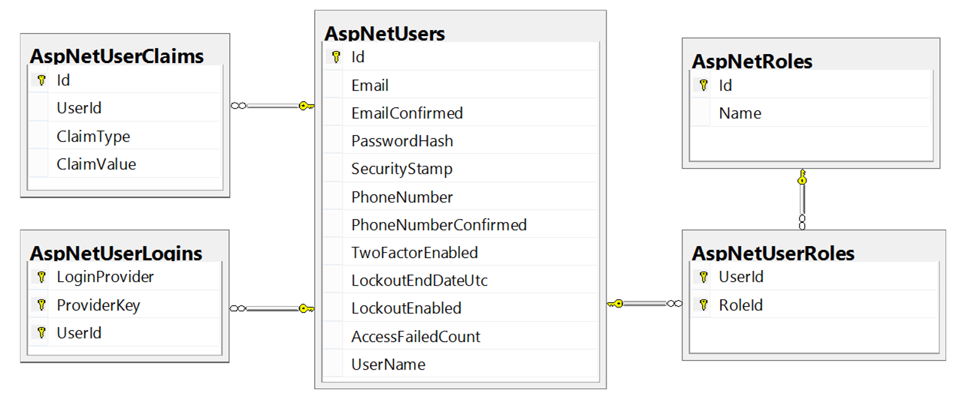
ASP.NET Identity and Entity Framework
Typically, the ASP.NET identity data (users, passwords, roles) is stored in relational database through EF Code First
You have some control over the internal database schema
ASP.NET Identity

